Slide 1

THE PHOTOMETRY GROUP
Team leaders:
Aleksandar Cikota
Dijana Vrbanec
Team members:
Ivana Barišić
Dino Bektešević
Neven Golenić
Lucija Šabarić

Slide 2

Introduction
Photometry is a procedure of measuring visible light in units that are weighted according to the sensitivity of the human eye
Variables - stars that change their brightness
Some stars vary in brightness because of physical changes, such as pulsations or eruptions and the others vary in light output due to eclipses or stellar rotation

Slide 3
Our aims
Reduce 20Gb of data from Tel Aviv Observatory and search for variable stars (18 nights)
Plot light curves of all stars (35 000)
Check all the light curves for variable stars
Determing if those stars are unknown
Photometry in Canopus
Approximately determine variable stars types
Photometry of an exoplanet
Check mira stars

Slide 4
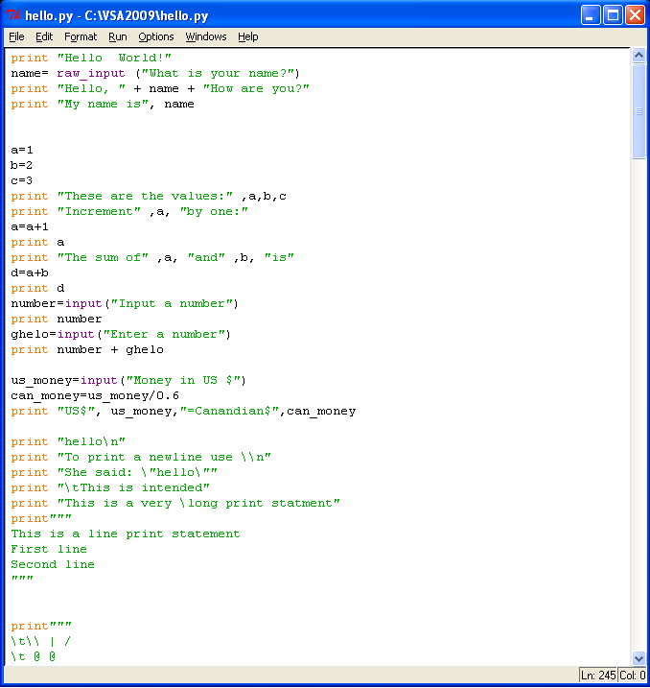

Python
learning basics of Python
writing a script for sorting images

Slide 5
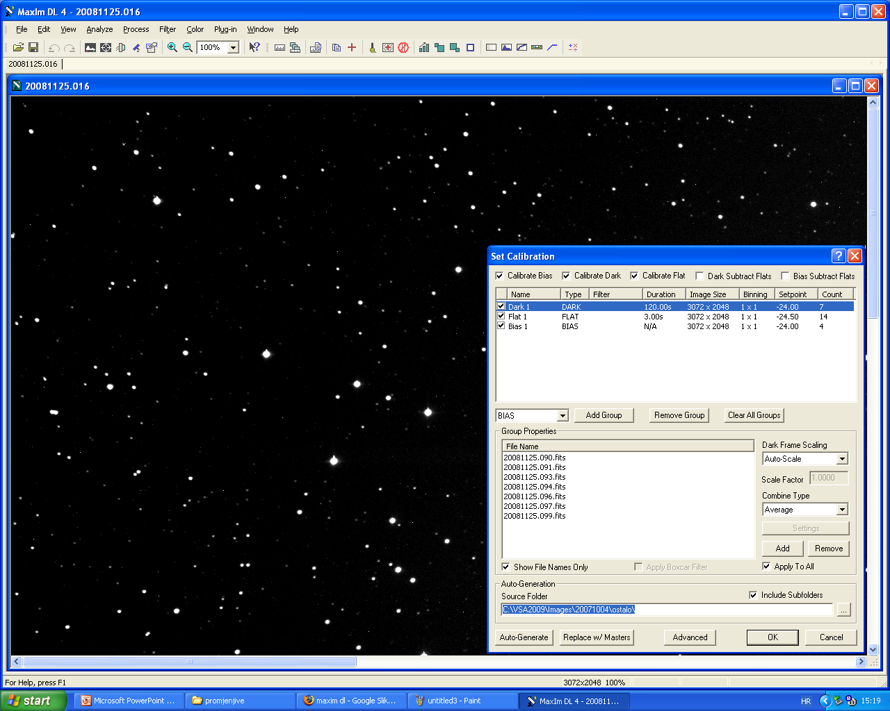
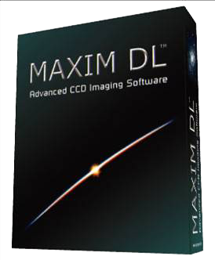
MaxIm DL
calibrating photos of variable stars

Slide 6
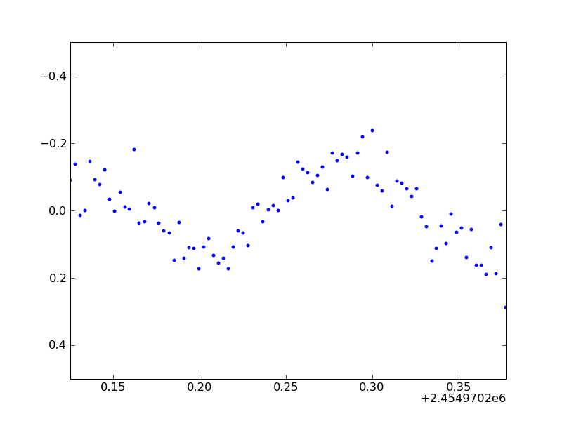
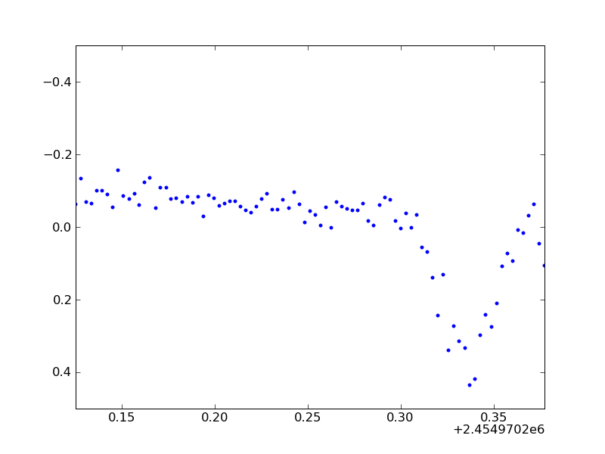
Plot script in Python
manipulates data created by the photometry script and creates graphical preview of numeric data

Slide 7

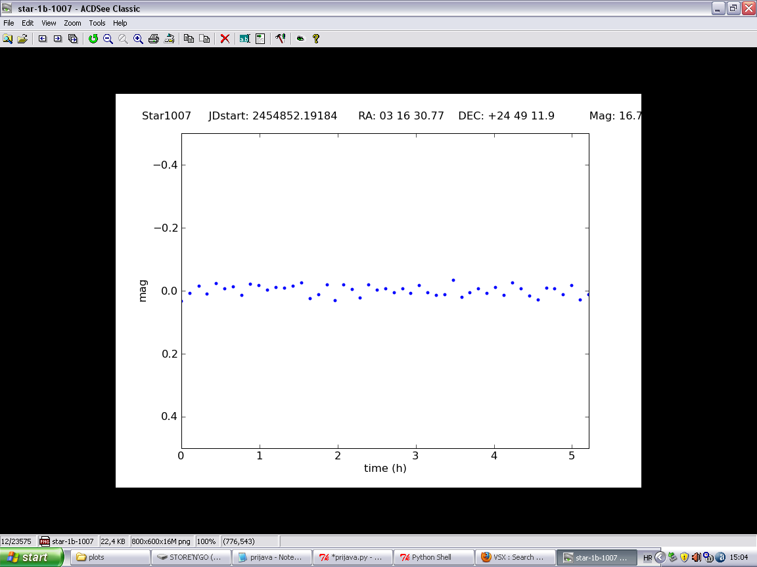
Variable stars plots
We checked all the plots (35 000)
Found 80 variable stars

Slide 8
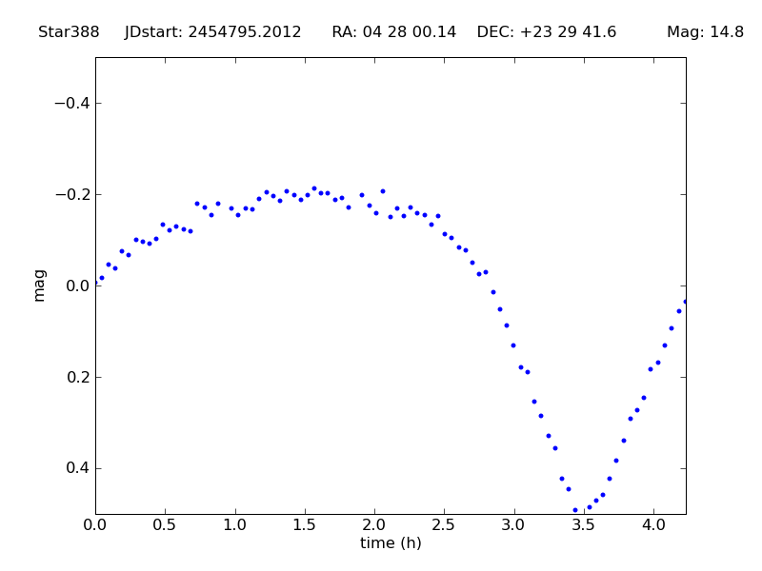
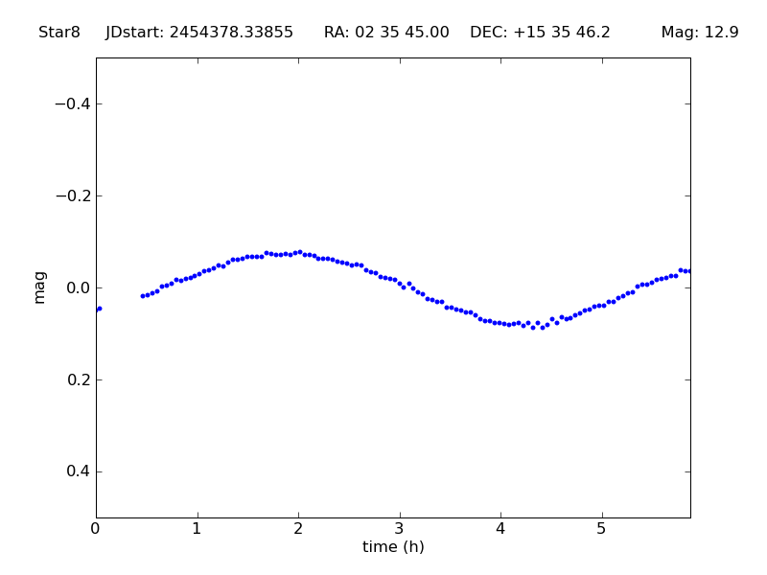
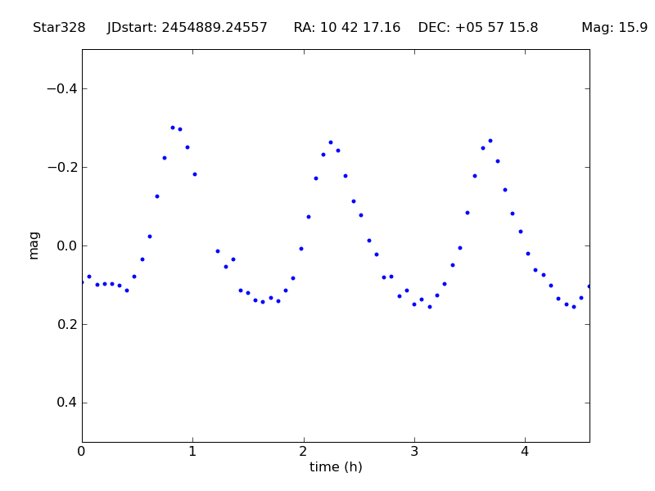
Variable stars

Slide 9
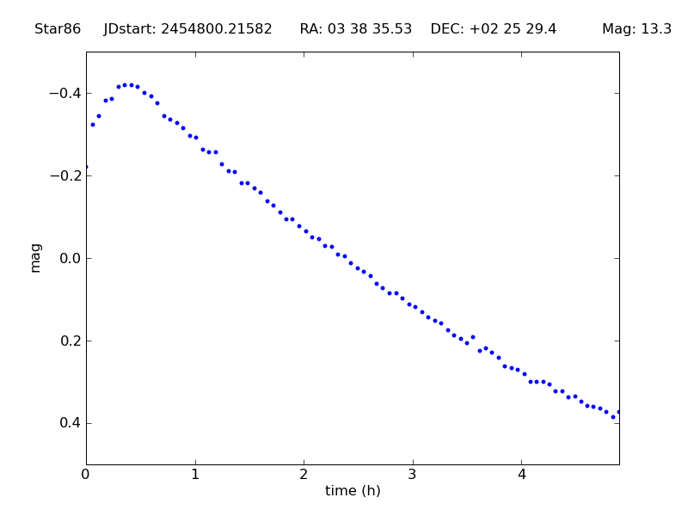
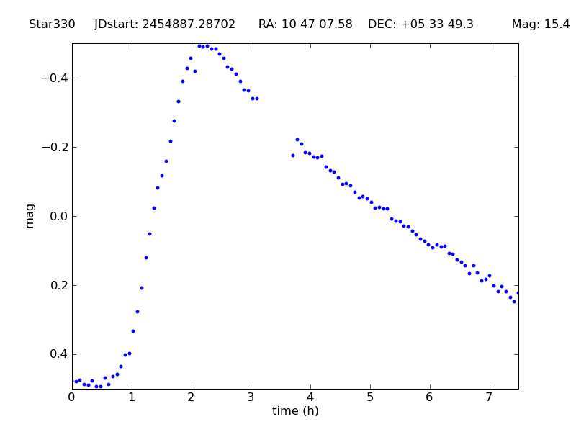
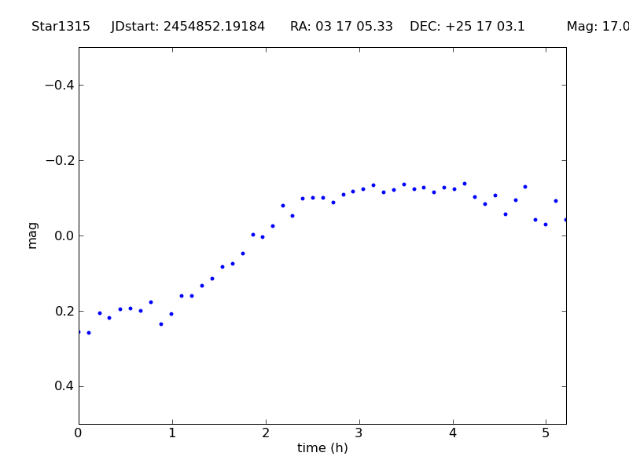
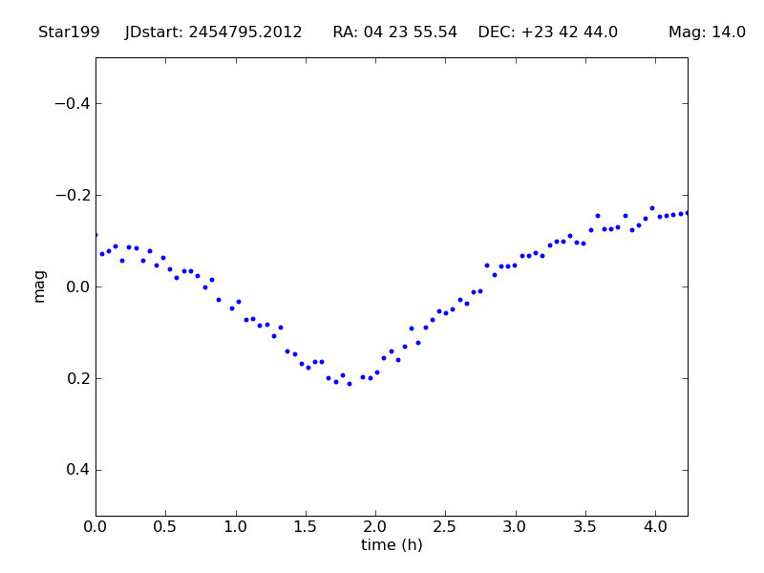

Slide 10
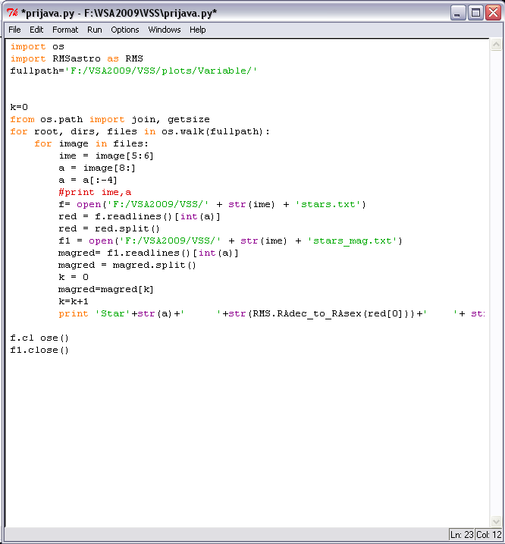
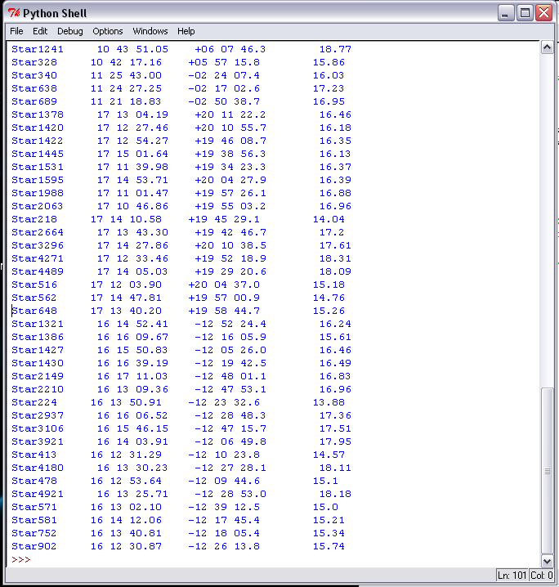
Output data
Script that prints out right ascension, declination, and magnitude

Slide 11
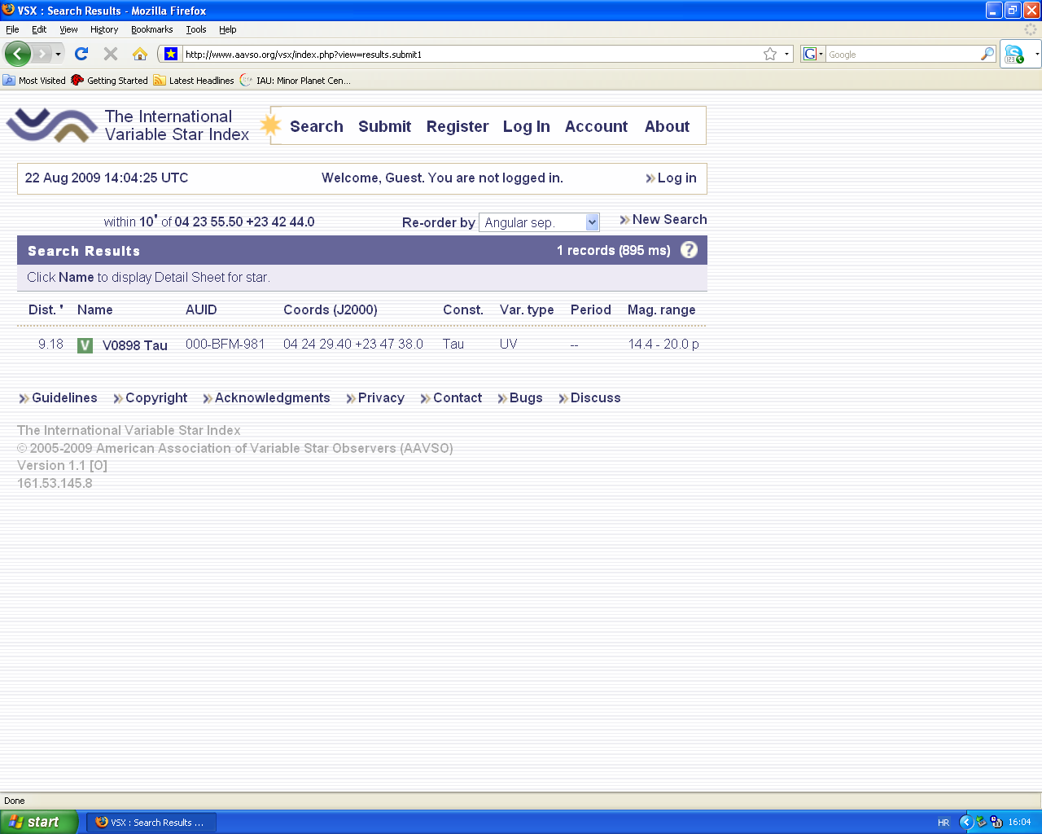
AAVSO
American association of variable stars observers
Web page that contains a list of variable stars
www.aavso.org contains VSX

Slide 12
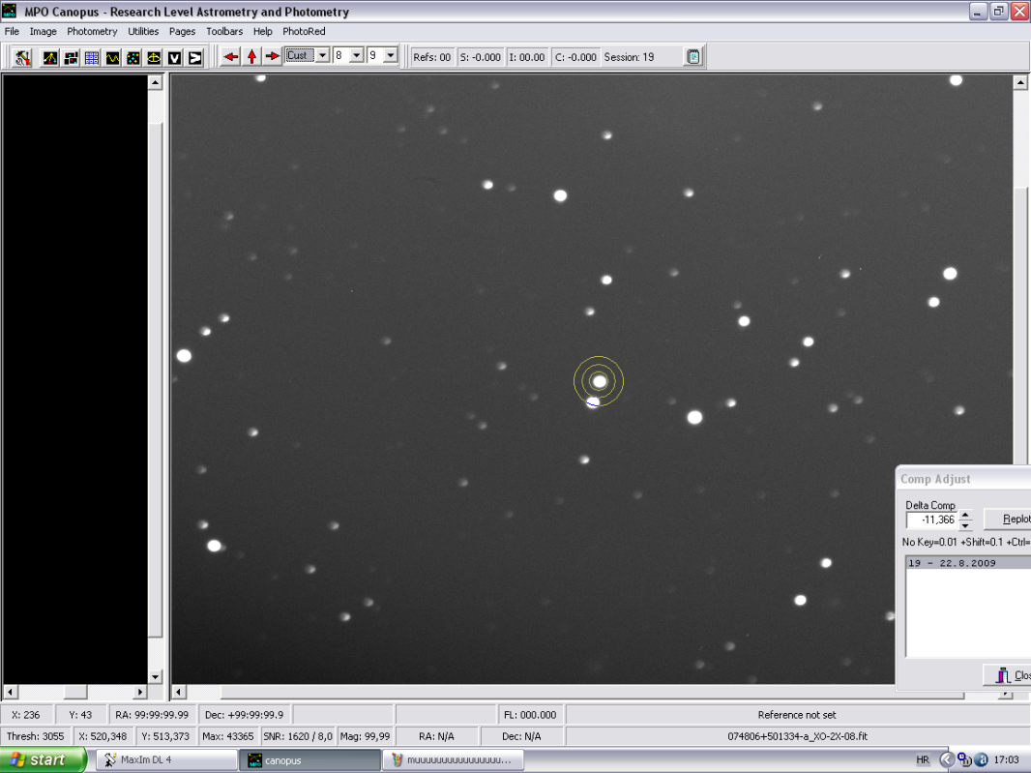
Canopus
Program for plotting
precise light curves
User is able to read
time, magnitude, and
derived period

Slide 13
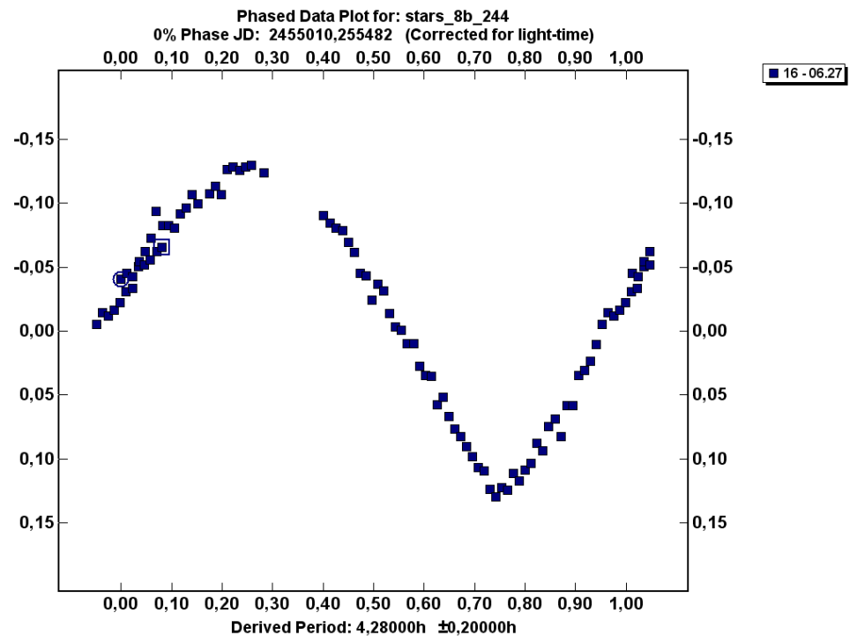
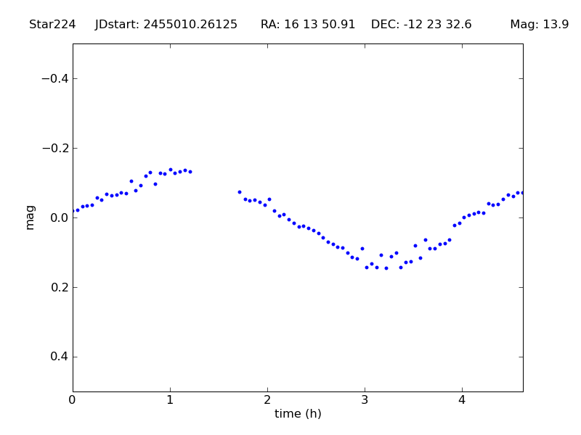
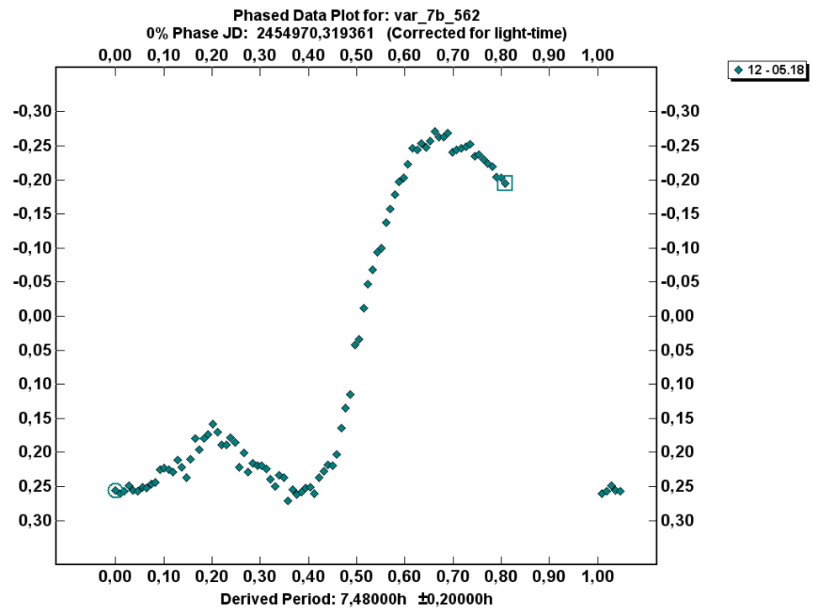
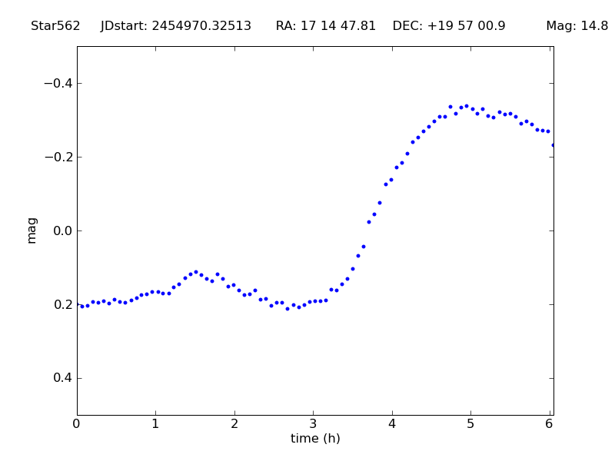

Slide 14
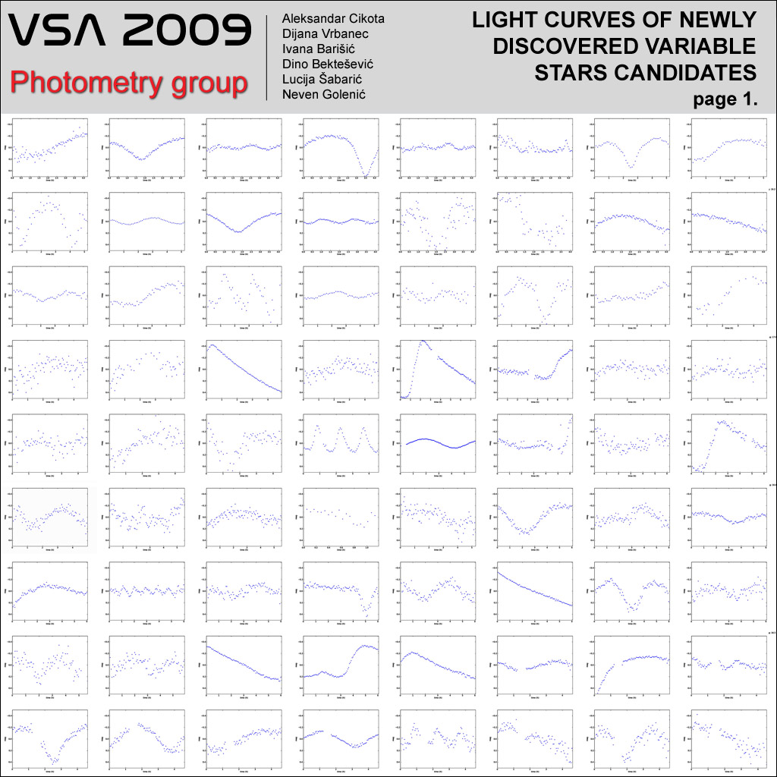

Slide 15
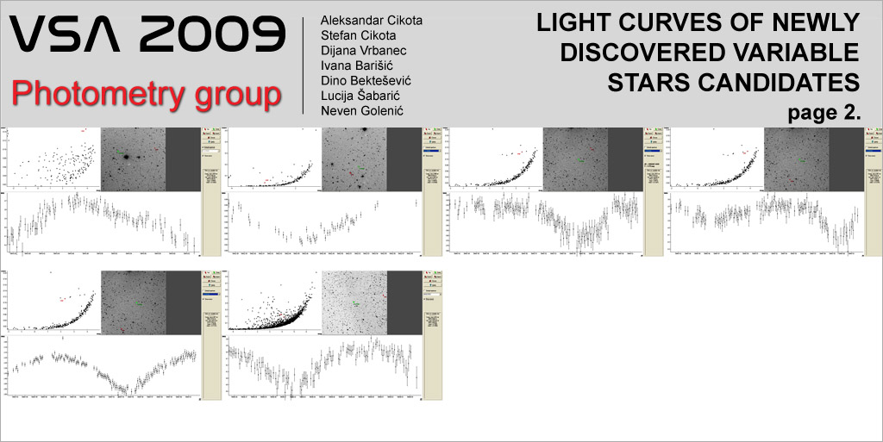

Slide 16
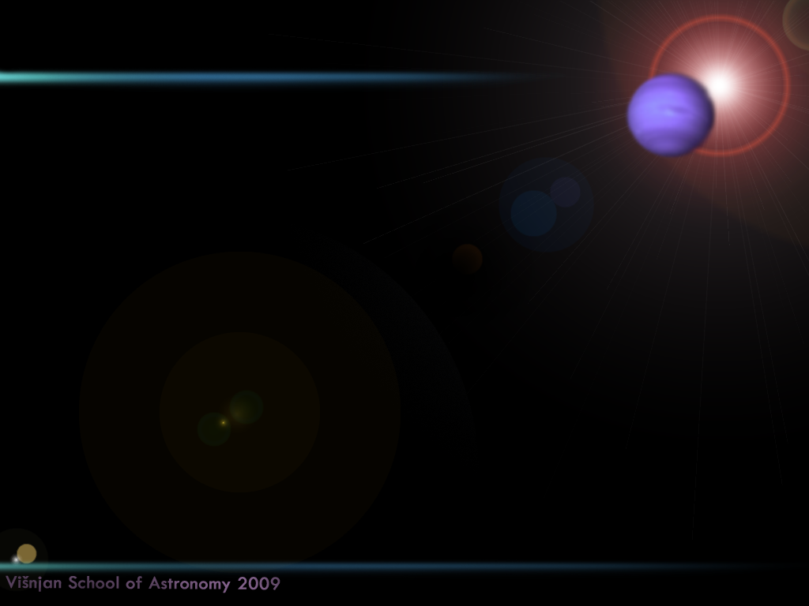
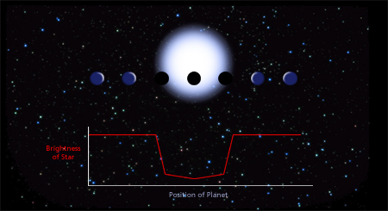
Exoplanet XO-2
Exoplanet or extrasolar planet is a planet that
evolves around other star (not Sun)
There are several ways of detecting exoplanets:
- the transit photometry method – our method
- the spectroscopic method
- astrometry mehod
- gravity lensing

Slide 17
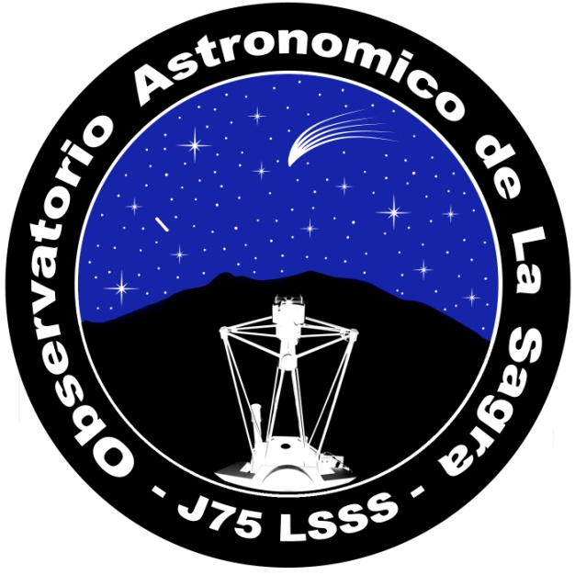
198 photos of XO-2 taken in the night of 07/03/2009 from La Sagra observatory
a lot of noise on images because of bad weather
Plotting light curve in Canopus
Determining all orbital parameters of the extrasolar planet XO-2 from it’s light curve

Slide 18
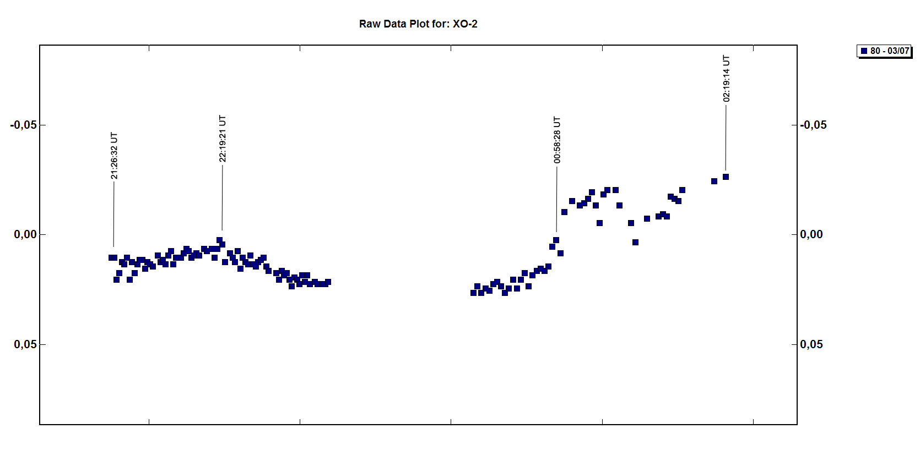

Slide 19

Mira variables
search for new LPV-s (long period variables or mira (ο Ceti) stars) that were considered as potential miras in Višnjan database
Check in other databases
Python- extracting star names and coordinates from html-s
Search in SDSS and SIMBAD

Slide 20
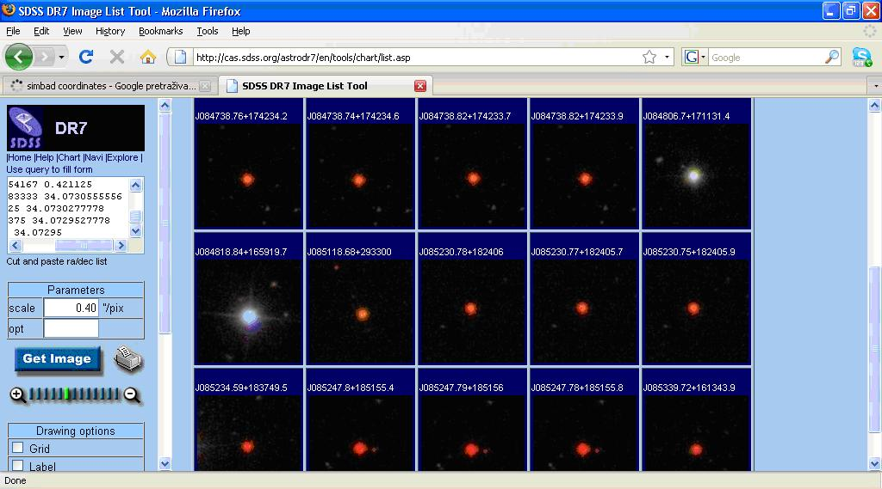
Mira variables - SDSS

Slide 21
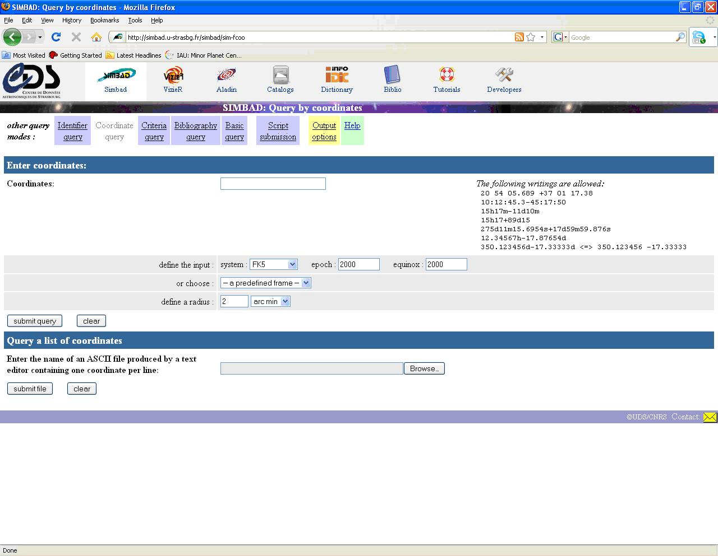
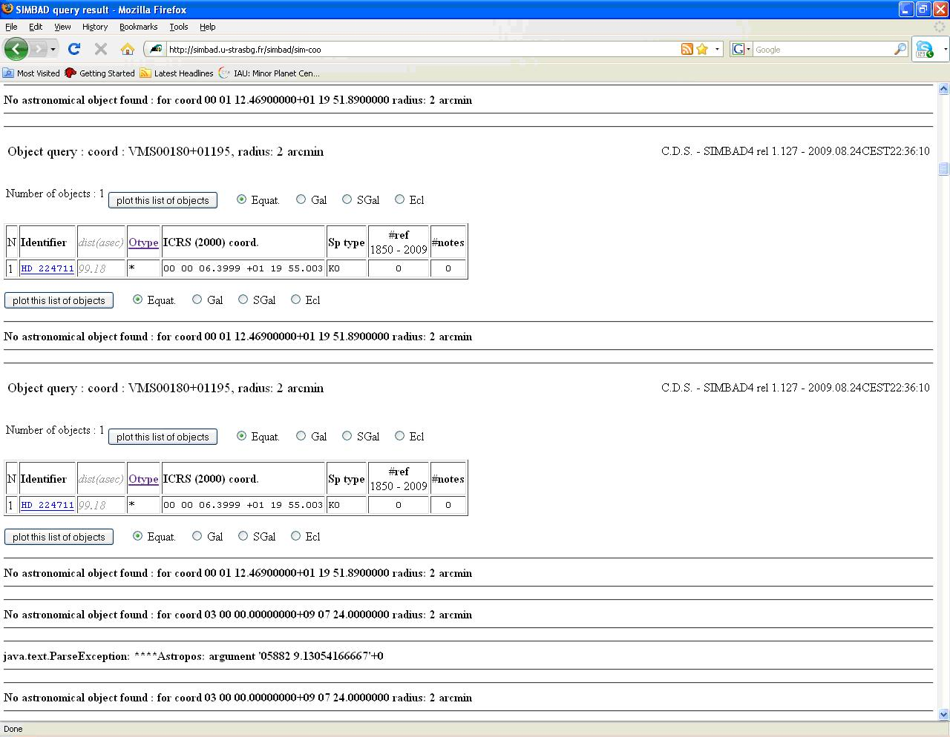
Mira variables - SIMBAD

Slide 22
Future goals
To publish new variable stars that we have found and their light curves in JAAVSO (Journal of the AAVSO)
Finish the search for new mira variables

Slide 23
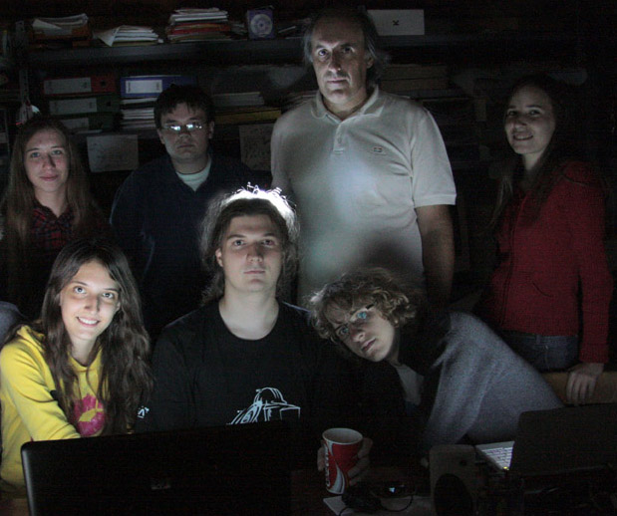
Thank you for your attention! Any questions? ☺

